Slide 1


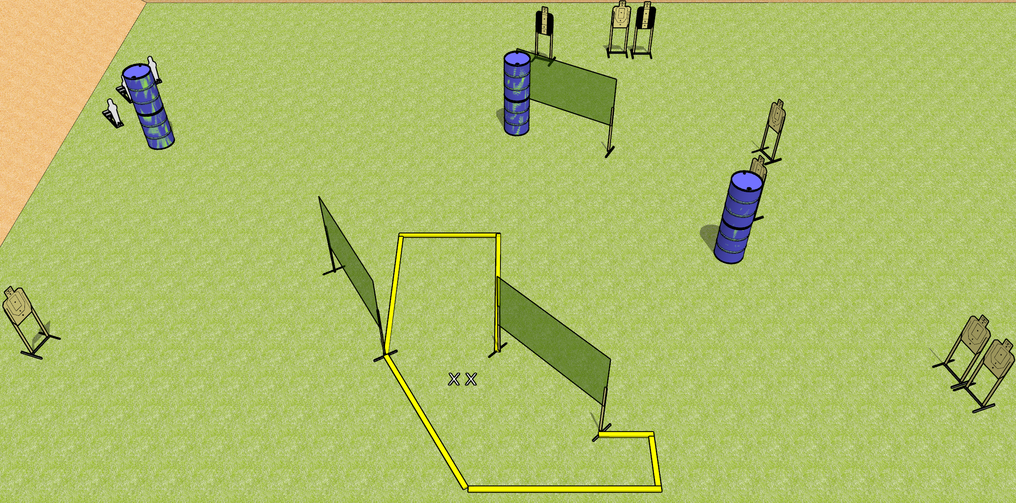
 | Dothan Gun Club – USPSA Match Diving About Course Designer : Drew Coleman
Round Count 19 rounds 8 USPSA targets 3 mini poppers
Equipment List 6 wall feet 3 medium fault lines 2 tuxedos

Slide 2
Diving About
Written Stage Briefing
Diving About is a 19 round, 95 point, Comstock course of fire. There are 8 USPSA targets and 3 mini poppers. The best 2 hits on paper will score and steel must fall to score. The start signal is audible.
Handgun start position is both feet on X’s, wrists below belt. Handgun is loaded and holstered.
PCC start position is both feet on X’s, stock on belt. Carbine is loaded with safety on.
On start signal, engage targets as they become available from within the shooting area.

